Slide 1
DBMS - Actors
Pravin Y Pawar

Slide 2
Actors
Users of DBMS
Day Today using Databases (on the scene)
Database Admins
Database Designers
System Analysts and Application Programmers
End users
Maintains the databases (behind the scene)
System designers and implementers
Tool developers
Operators and maintenance personnel

Slide 3
On the scene actors
Deals directly with data
DBA
Oversees and manages the database resources
Responsible for access management, usage monitoring
Needs to look into security aspects, and performance issues
In large organizations, pool of DBAs can be deployed for these purpose
Database Designers
Defines the schema and actual data which needs to be stored in database
Identifies the data to be stored in the database and select proper structures for the same
Needs to interact with all stakeholders to understand their data requirements and then design the database matching to those requirements
Needs to design views of database based on users requirements

Slide 4
On the scene actors
System Analysts
Determine the requirements of end users and prepares the standard canned transactions
Application Programmers
Implements the specifications as programs, test, debug and maintain it
Needs to be familiar with full range of capabilities of DBMS
End Users
Casual
occasionally access database through standard query interface
Middle or high level managers
Naïve (Parametric)
sizeable portion of users
uses standard types of queries (canned transactions) to deal with database
Sophisticated
knows thoroughly about capabilities of DBMS and implements query / programs to fulfil their data requirements
Standalone
uses menu based user interface to interact with database

Slide 5
Behind the Scene
Not interested into the content of database
System designers and implementers
DBMS is complex software – backup , security, catalog, query processing , interface etc.
Design and implement these modules and interfaces
Tool developers
Implements tools that facilitates database modeling and design, database system design etc.
Many times optional, needs to be purchased / obtained separately need basis
Performance monitoring tools, graphical interfaces etc.
Operators and Maintenance personnel
Responsible for actual running and maintenance of hardware and software environment for DBMS

Slide 6
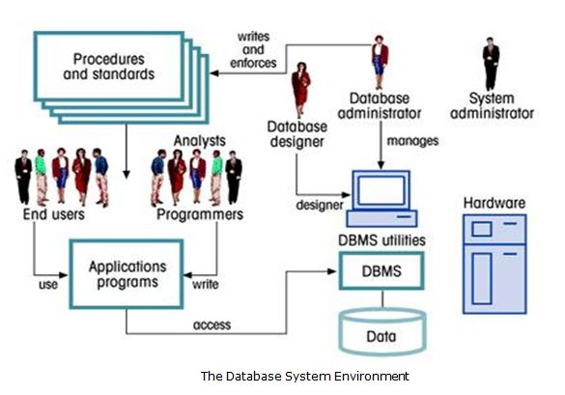
In Summary
Source : MyReadingRoom

Slide 7
Thank You!
Reference :
Fundamentals of Database Systems, by Elmasri, Navathe
In our next session:

